Slide 1
What do you love?
In this area, paste images or write words of things that you love.

Slide 2
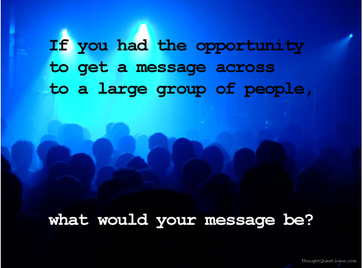

Slide 5
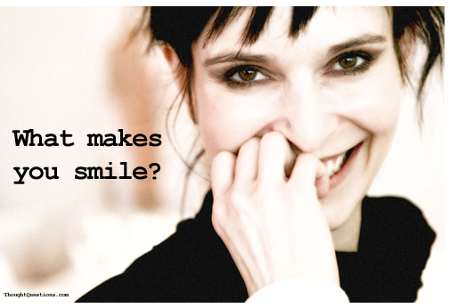

Slide 6
What upsets you?
What do you think is unfair?

Slide 7
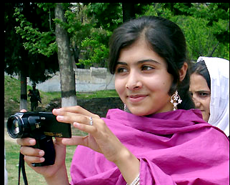
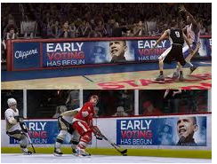
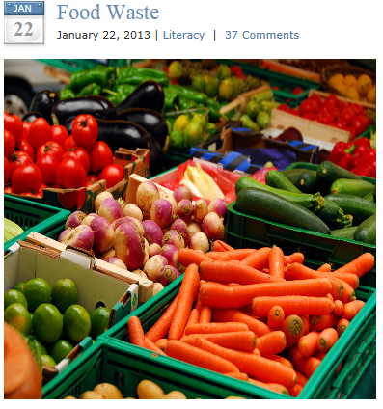
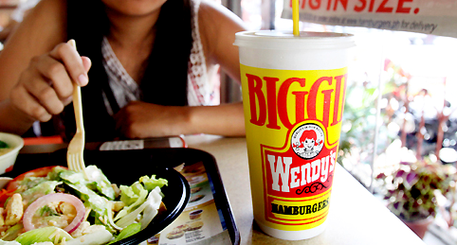
What hot topic issue/article interested you the most? Why?

Slide 9
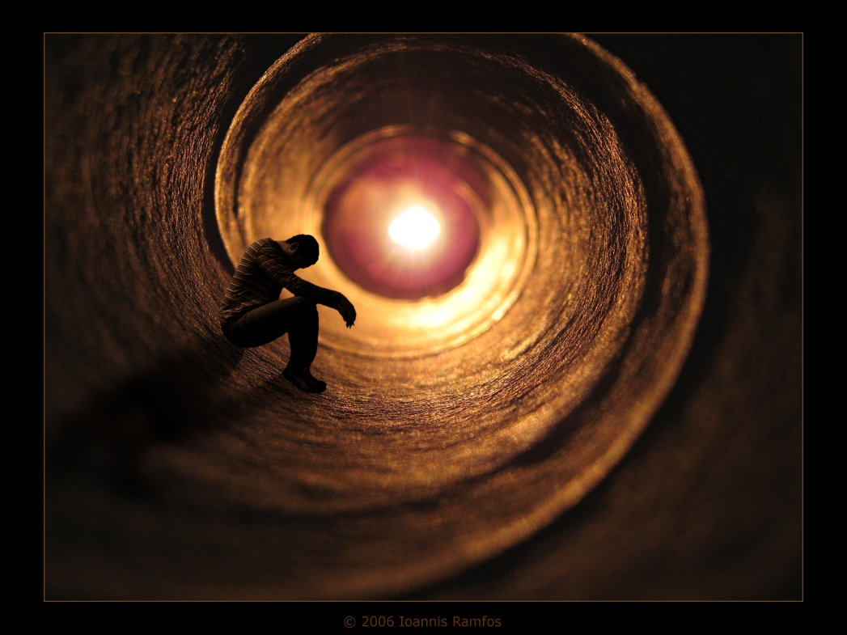
What do you think about often?

Slide 10
