Slide 1
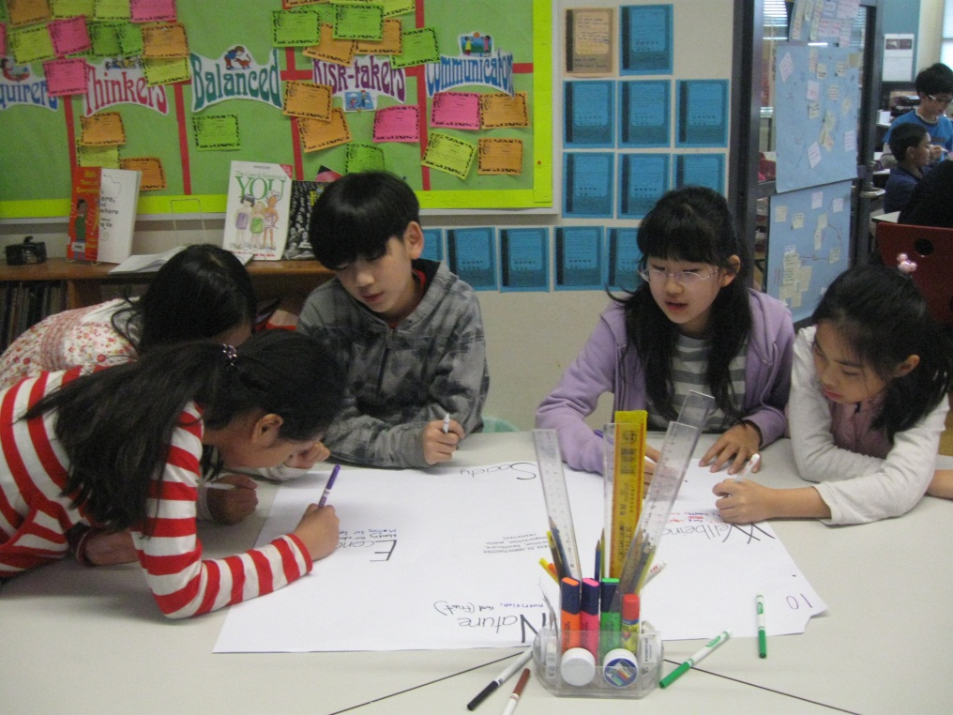
The Exhibition
UNIS Hanoi
2012

Slide 2
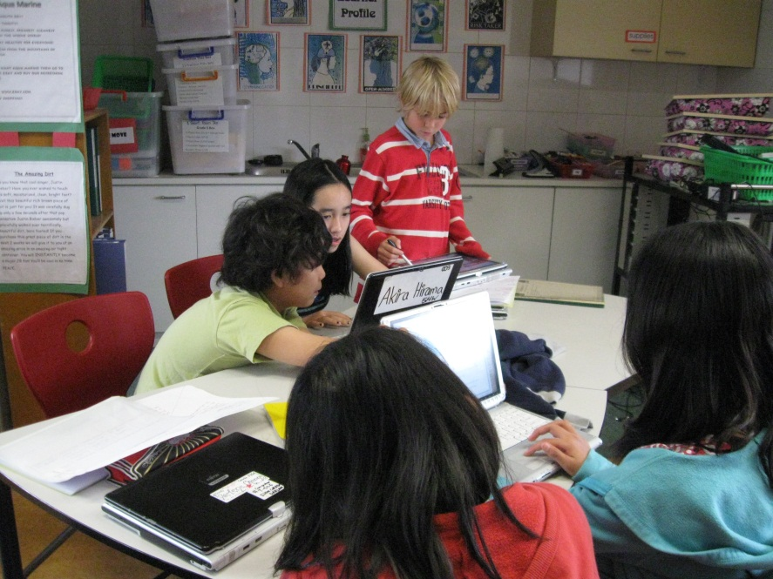
What do you already know?

Slide 3
The Purpose of the Exhibition
to synthesize and apply their learning of previous years and to reflect upon their journey through the PYP
for students to engage in an in-depth, collaborative inquiry
to unite the students, teachers, parents and other members of the school community in collaboration
To incorporate the essential elements of the PYP
to demonstrate how students can take action as a result of their learning

Slide 4
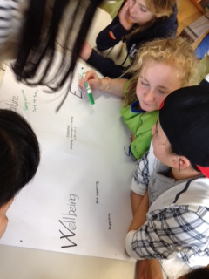
Transdisciplinary Theme
Sharing the Planet
An inquiry into rights and responsibilities in the struggle to share finite resources with other people and with other living things; communities and the relationships within and between them; access to equal opportunities; peace and conflict resolution.

Slide 5
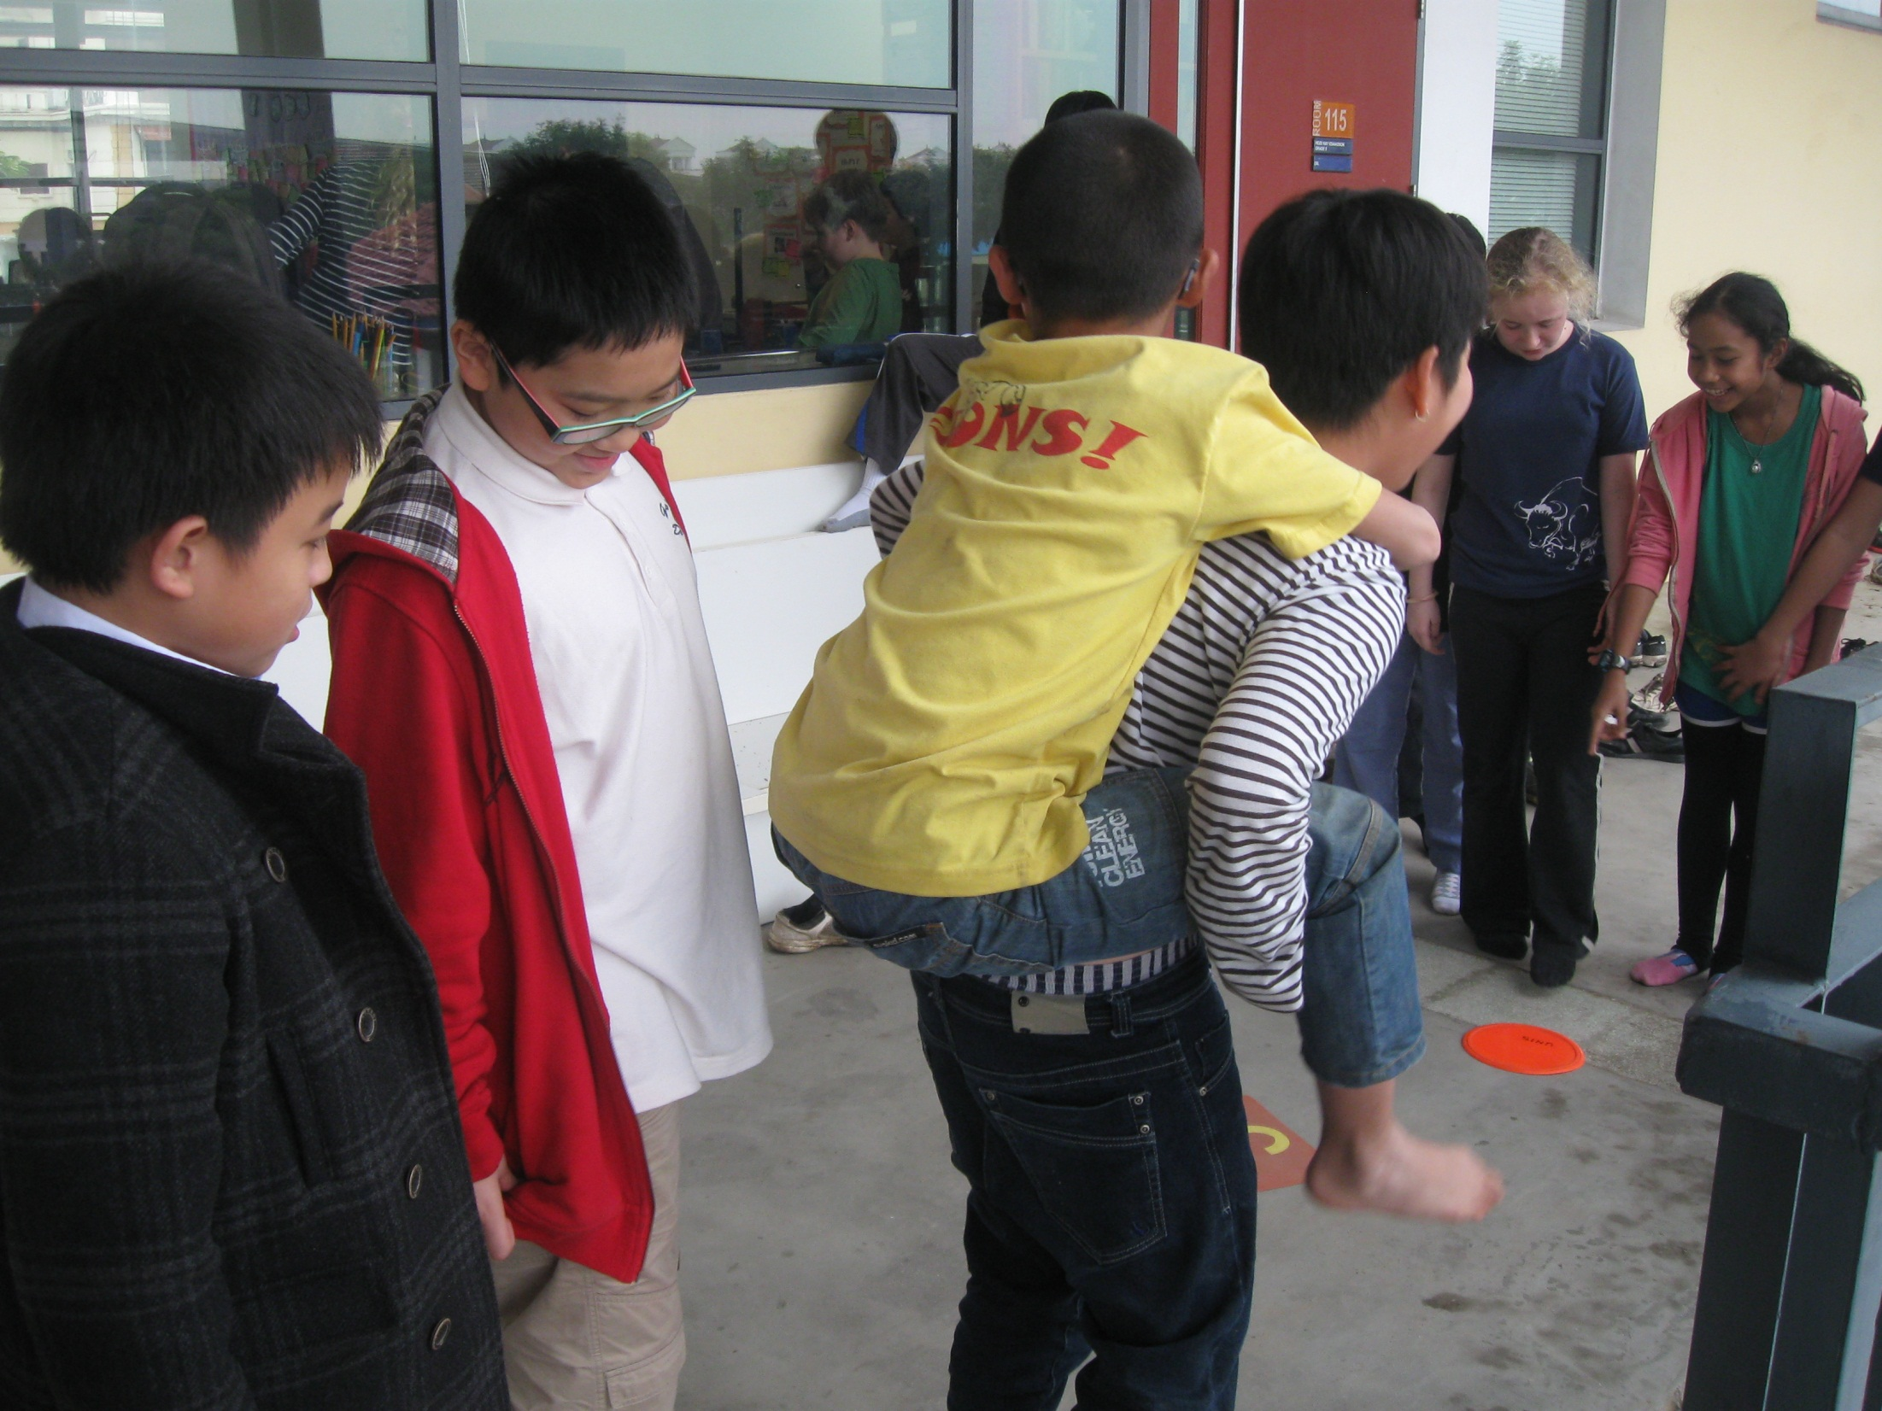

Slide 6
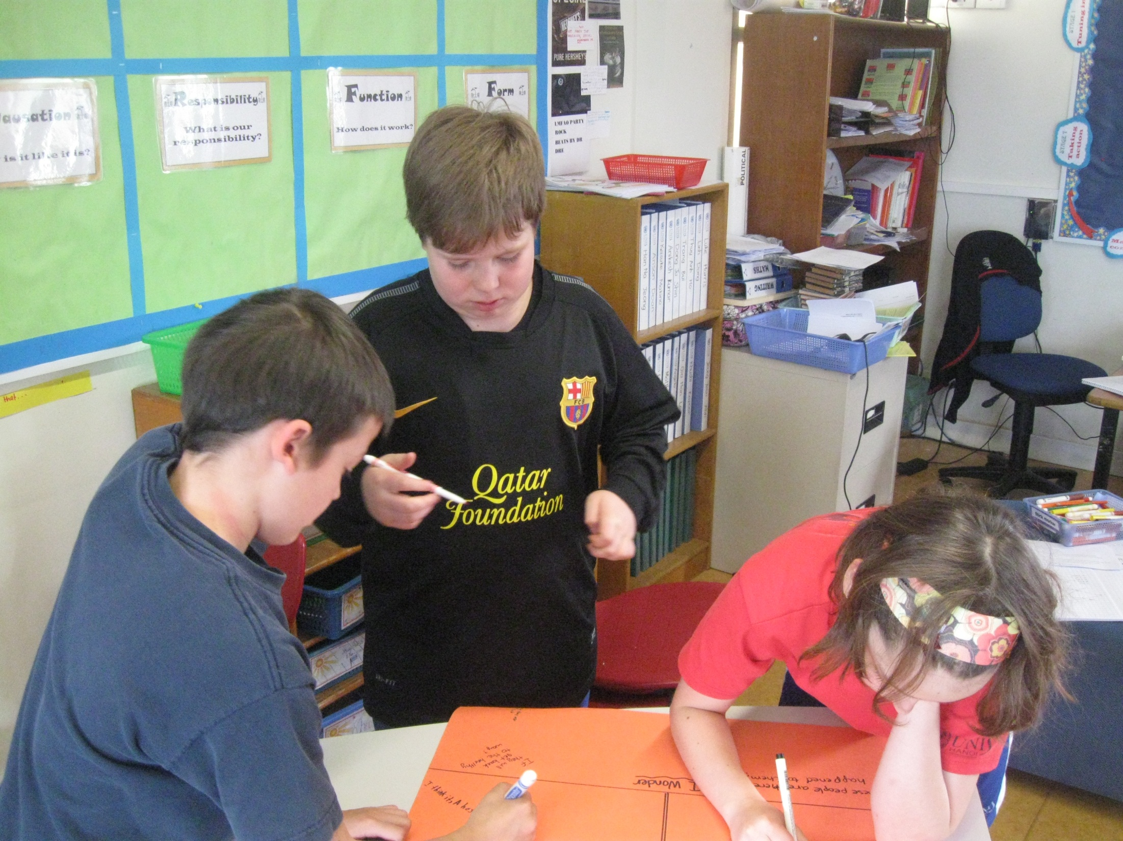

Slide 7
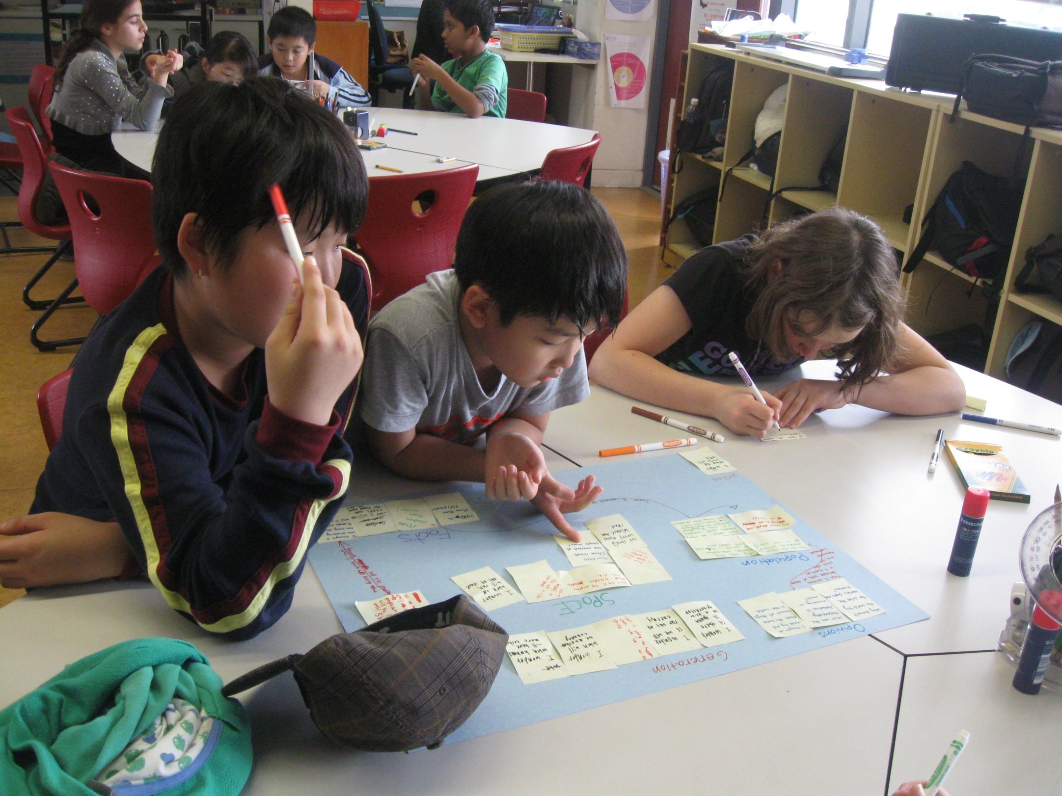

Slide 8
Central Idea
People’s actions impact the world in which we live.

Slide 9
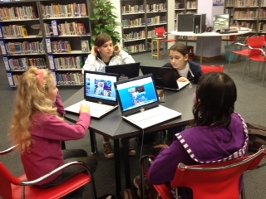

Slide 10
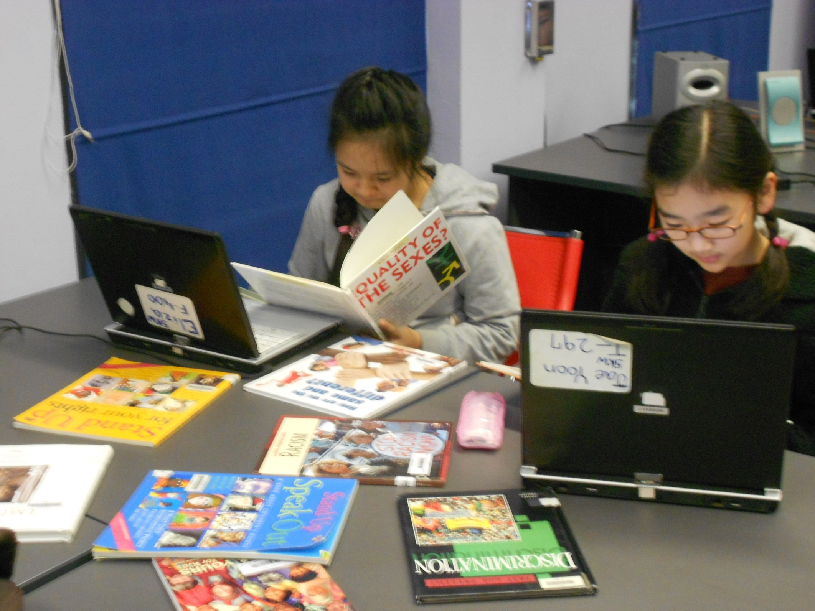

Slide 11
Self Directed Inquiry
Group work/independent work
Lines of inquiry

Slide 12
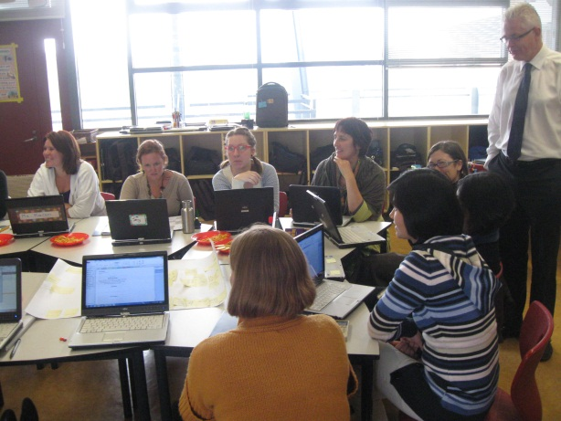
Staffing
Throughout the Exhibition your
child will be working with many staff members.
Students will be grouped across all grade 5 classes and will be given an Exhibition Teacher. Ms. Mindy, Ms. Heidi, Ms. Jenny, Ms. Karen or Ms. Marcelle.
Student groups will be given a Mentor who will meet with the group once a week.
Specialists teachers will also work closely with students to help assist their inquiry. Art, Music, PE, Drama and Language.

Slide 13
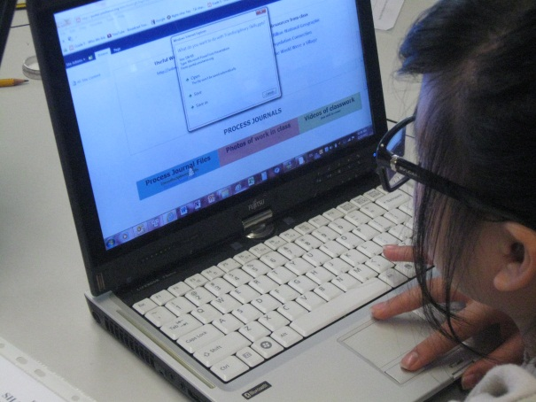
Schedule
Flexible scheduling
Mentor meeting
Subjects incorporated into the Exhibition

Slide 14
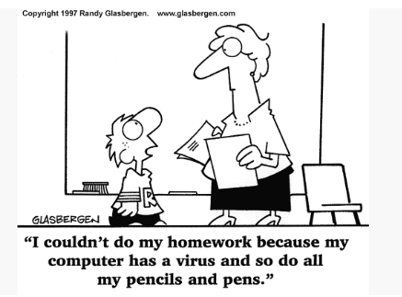
Homework
Set by self and group and independently motivated
Will vary in length throughout exhibition
Students responsible for time management (procedures in place to assist)

Slide 15
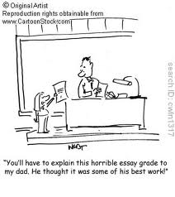
What can you do to help at home
Digital process journals and Google Docs
Allow this to be a child’s inquiry
Research (words and search terms)
Help broaden or focus your child’s questioning
Types of questioning that lead to
discovery and encourage
communication

Slide 16
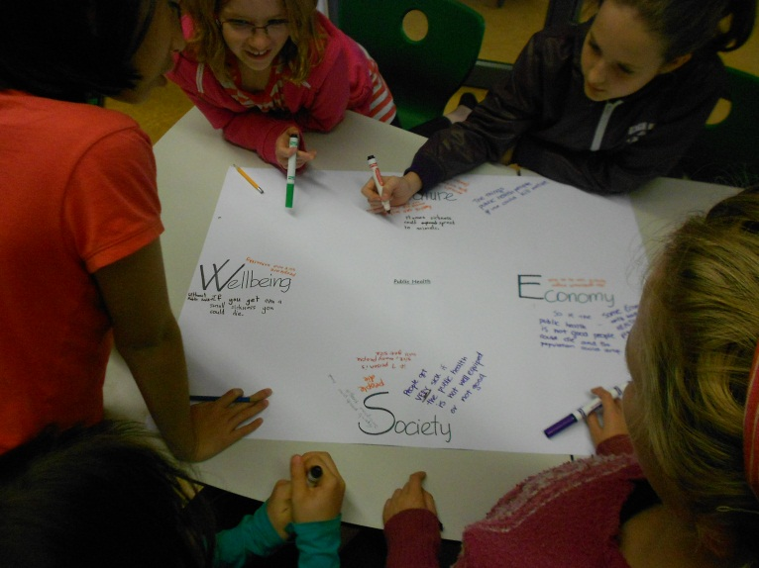
What can you do to help at home
Languages
Discussing progress, not too much focus on the end-product
Guest speakers, field trips, communication with schools

